Slide 1

ML Summary and Next Steps in Illustrations Data X: A Course on Data, Signals, and Systems
Data ^{X}
About Me:
Ikhlaq Sidhu Chief Scientist & Founding Director, Sutardja Center for Entrepreneurship & Technology IEOR Emerging Area Professor Award, UC Berkeley

Slide 2
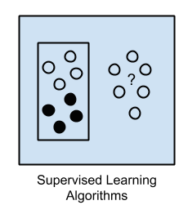
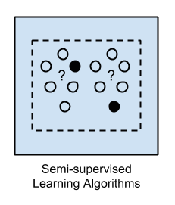
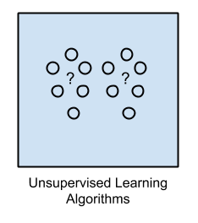
Overview

Slide 3
Overview
#Setting up for Supervised learning
# First clean: use mapping + buckets
# X = matrix of data – e.g 1000 rows
# Y = In sample responses
# Typically we want to split in to training data and test data
X_train = X[0:500]
Y_train = Y[0:500]
X_test = X[501:1000]
Y_test = Y[501:1000]

Slide 4
Linear Regression Illustration
#Setting Linear Regression in sklearn
from sklearn import linear_model
model= linear_model.LinearRegression()
model.fit(X_train, Y_train)
Y_pred_train = model.predict(X_train)
Y_pred_test = model.predict(X_test)
# Compare Y_pred_test with Y_test for error.
Illustration Source:

Slide 5
Logistic Regression Illustration
Illustration Source:

Slide 6
Logistic Regression Illustration
from sklearn.linear_model import LogisticRegression
# Logistic Regression
logreg = LogisticRegression()
logreg.fit(X_train, Y_train)
Y_pred = logreg.predict(X_test)
# Error
acc_log = round(logreg.score(X_train, Y_train) * 100, 2)
acc_log
# or compare Y_pred with Y_test
Illustration Source:

Slide 7
Support Vector Machine (SVM) Illustration
Illustration Source:

Slide 8
Support Vector Machine (SVM) Illustration
from sklearn.svm import SVC, LinearSVC
svc = SVC()
svc.fit(X_train, Y_train)
Y_pred = svc.predict(X_test)
# Error
acc_svc = round(svc.score(X_train, Y_train) * 100, 2)
acc_svc
# or compare Y_pred with Y_test
Illustration Source:

Slide 9
Support Vector Machine (SVM) Illustration
from sklearn.svm import SVC, LinearSVC
# Linear SVC
linear_svc = LinearSVC()
linear_svc.fit(X_train, Y_train)
Y_pred = linear_svc.predict(X_test)
# Error:
acc_linear_svc = round(linear_svc.score(X_train, Y_train) * 100, 2)acc_linear_svc
# or compare Y_pred with Y_test
Illustration Source:

Slide 10
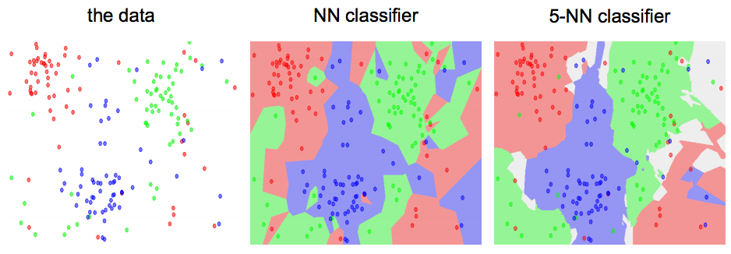
KNN / K Means Illustration
KNN Method: Find the k nearest images and have them vote on the label (i.e. take the mode)
Illustration Source:

Slide 11
K Means / KNN Illustration
from sklearn.neighbors import KNeighborsClassifier
knn = KNeighborsClassifier(n_neighbors = 3)
knn.fit(X_train, Y_train)
Y_pred = knn.predict(X_test)
acc_knn = round(knn.score(X_train, Y_train) * 100, 2)
acc_knn
# or compare Y_pred with Y_test
KNN Method: Find the k nearest images and have them vote on the label (i.e. take the mode)
Illustration Source:

Slide 12
Decision Tree Illustration
Illustration Source:

Slide 13
Decision Tree Illustration
from sklearn import tree
decision_tree = DecisionTreeClassifier()
decision_tree.fit(X_train, Y_train)
Y_pred = decision_tree.predict(X_test)
# Error
acc_decision_tree = round(decision_tree.score(X_train, Y_train) * 100, 2)
acc_decision_tree
# or compare Y_pred with Y_test
Illustration Source:

Slide 14
Our experiment with the Titanic Data Set
 | Model | Score
 | Random Forest | 86.76
 | Decision Tree | 86.76
 | KNN | 84.74
 | Support Vector Machines | 83.84
 | Logistic Regression | 80.36
 | Linear SVC | 79.01
 | Perceptron | 78.00
 | Naive Bayes | 72.28
 | Stochastic Gradient Decent | 72.28
More Accuracy
Generally more training time
More risk of overfitting
Less Accuracy
Generally less computation

Slide 15
Neural Network Illustration
Illustration Source:

Slide 16
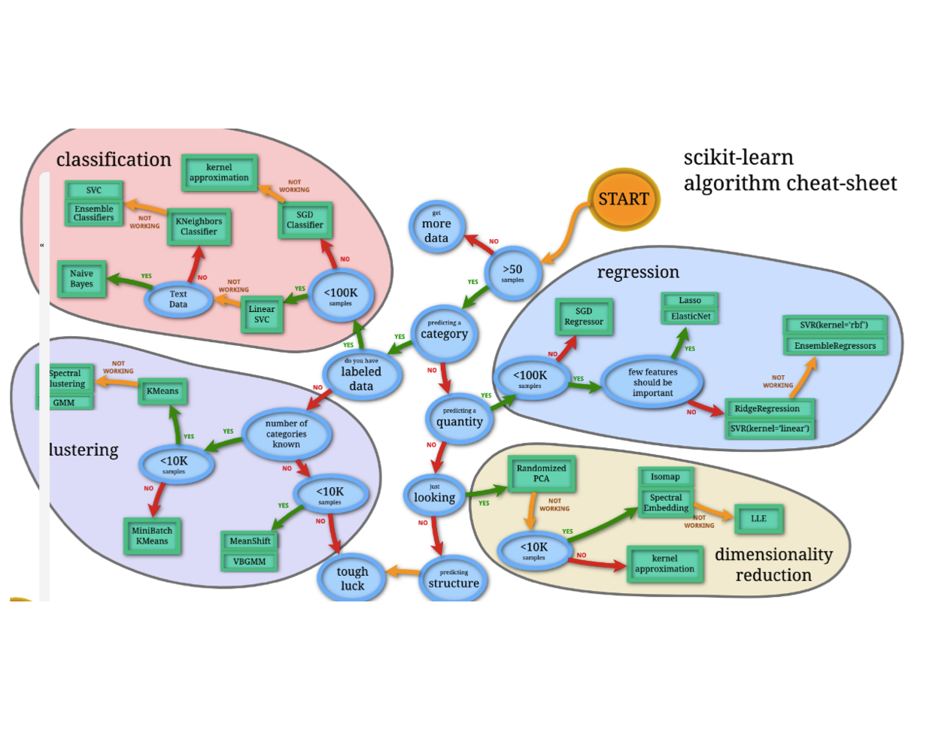
Scikit-Learn Algorithm

Slide 17
Illustration Source:

Slide 18
End of Section

